Slide 1
Section 9.2
Infinite Series:
“Monotone Sequences”

Slide 2
All graphics are attributed to:
Calculus,10/E by Howard Anton, Irl Bivens, and Stephen Davis
Copyright © 2009 by John Wiley & Sons, Inc. All rights reserved.”

Slide 3
Introduction
There are many situations in which it is important to know whether a sequence converges, but the value of the limit is not relevant to the problem at hand.
In this section, we will study several techniques that can be used to determine whether a sequence converges.

Slide 4
Important Note
An increasing sequence need not be strictly increasing, and a decreasing sequence need not be strictly decreasing.
A sequence that is either increasing or decreasing is said to be monotone.
A sequence that is either strictly increasing or strictly decreasing is said to be strictly monotone.

Slide 5
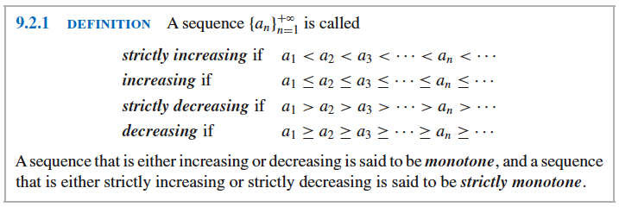
Formal Definition
Jkgkljg

Slide 6
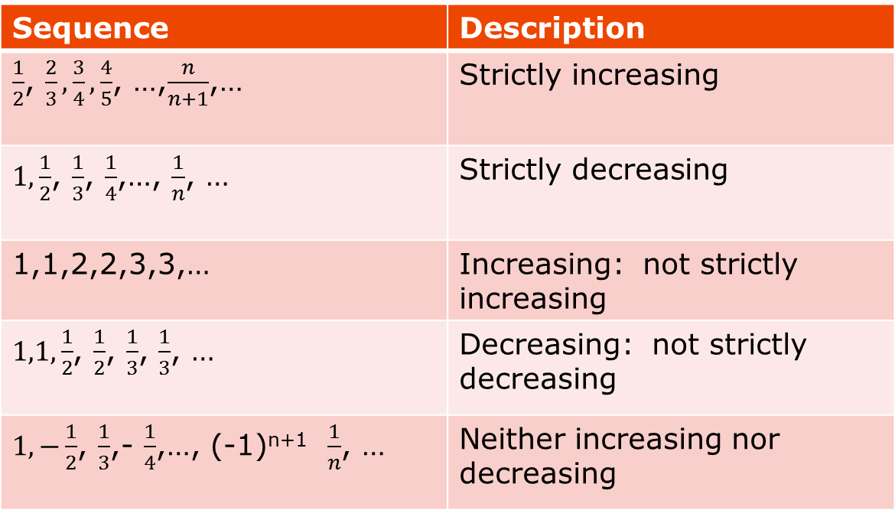
Examples
Sequence | Description
$\frac{1}{2}$, $\frac{2}{3}, \frac{3}{4}, \frac{4}{5}$, …,$\frac{n}{n+1}$,… | Strictly increasing
$1,\frac{1}{2}$, $\frac{1}{3}$, $\frac{1}{4}$,…, $\frac{1}{n}$, … | Strictly decreasing
1,1,2,2,3,3,… | Increasing: not strictly increasing
$1,1,\frac{1}{2}$, $\frac{1}{2}$, $\frac{1}{3}$, $\frac{1}{3}$, … | Decreasing: not strictly decreasing
$1,−\frac{1}{2}$, $\frac{1}{3}$,- $\frac{1}{4}$,…, (-1)^{n+1} $\frac{1}{n}$, … | Neither increasing nor decreasing

Slide 7
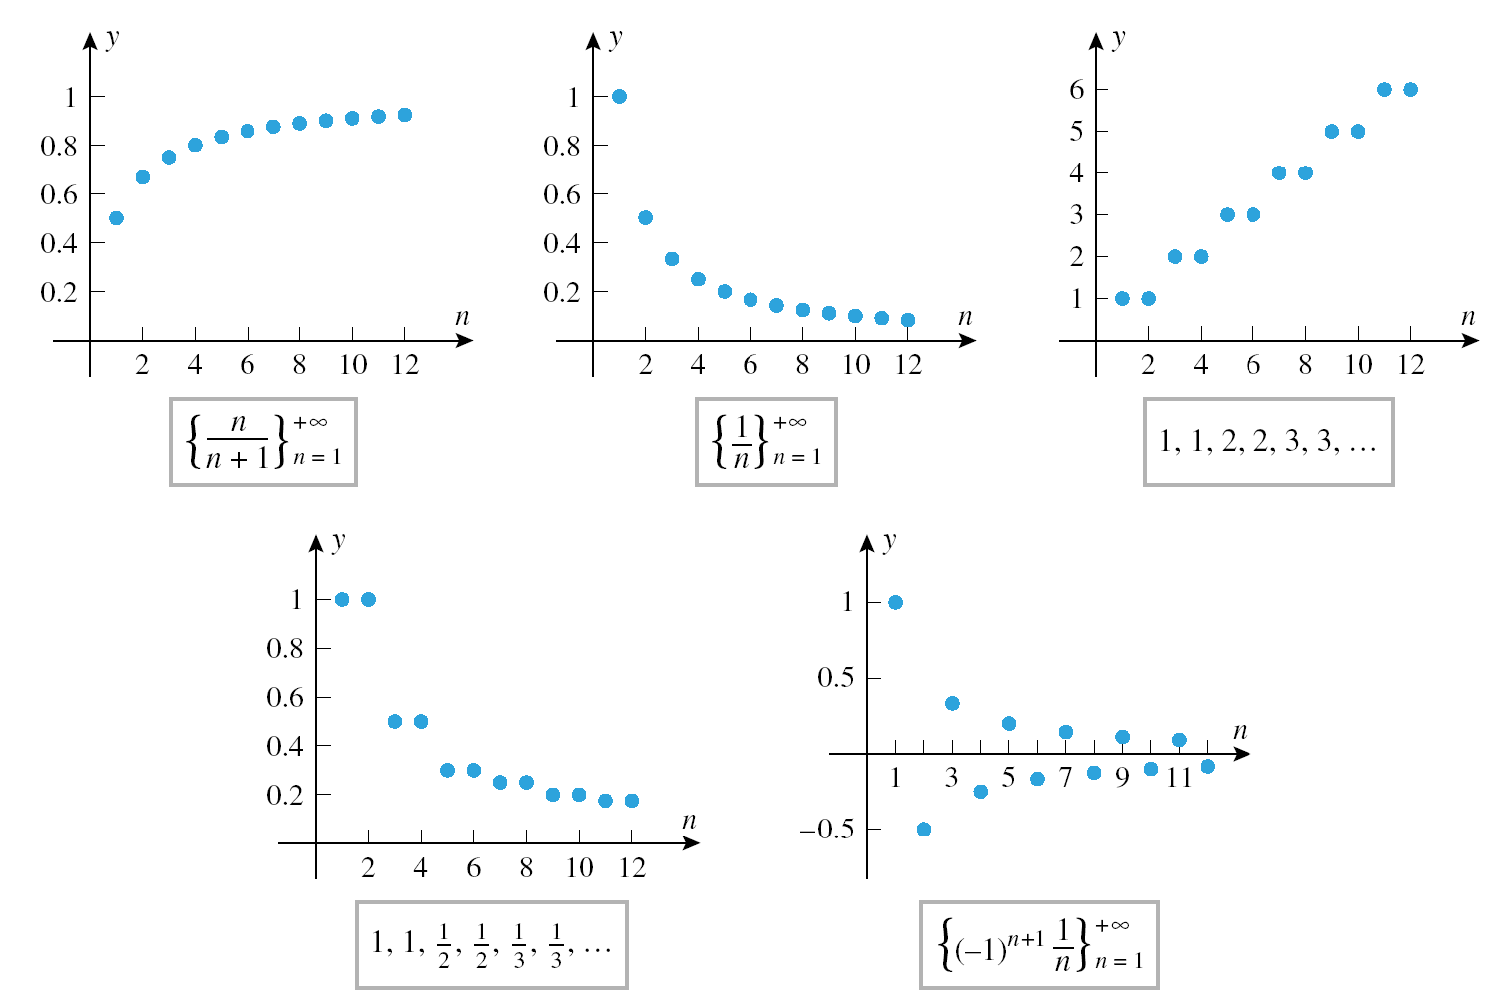
Graphs of Examples on Previous Slide
efgadg

Slide 8
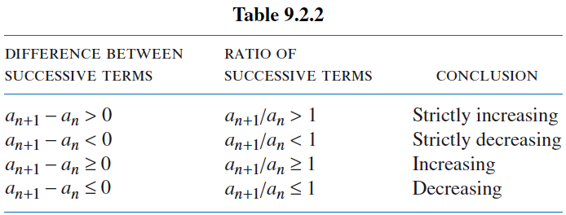
Testing for Monotonicity
Frequently, one can guess whether a sequence is monotone or strictly monotone by writing out some of the initial terms.
However, to be certain that the guess is correct, one must give a precise mathematical argument.
Here are two ways of doing this:

Slide 9
Two Ways to Test for Monotonicity
The first method is based on the differences of successive terms.
The second method is based on ratios of successive terms (assuming all terms are positive).
For either method, one must show that the specified conditions hold for ALL pairs of successive terms.
This is somewhat similar to proofs by mathematical induction you may have done in Algebra II.

Slide 10

Example Using Differences of Successive Terms
Use differences of successive terms to show that $\frac{1}{2}$, $\frac{2}{3}, \frac{3}{4}, \frac{4}{5}$, …,$\frac{n}{n+1}$,… is a strictly increasing sequence.
Solution:
  Let $a_{n}$= $\frac{n}{n+1}$
  Obtain $a_{n+1}$ by substitution: $a_{n+1}$ = $\frac{n+1}{(n+1)+1}$ = $\frac{n+1}{n+2}$
  Calculate $a_{n+1}$ - $a_{n}$ for n$≥1$ : $a_{n+1}$ - $a_{n}$ = $\frac{n+1}{n+2}$ - $\frac{n}{n+1}$
  = $\frac{(n+1)(n+1)}{(n+2)(n+1)}$ - $\frac{n(n+2)}{(n+1)(n+2)}$
  = $\frac{n^{2}+2n+1}{(n+2)(n+1)}$ - $\frac{n^{2}+2n}{(n+1)(n+2)}$
  = $\frac{1}{(n+2)(n+1)}$ > 0
  which proves that the sequence is strictly increasing since the difference is always positive (>0).

Slide 11

Same Example Using Ratios of Successive Terms
Solution:
  Let $a_{n}$= $\frac{n}{n+1}$
  Obtain $a_{n+1}$ by substitution: $a_{n+1}$ = $\frac{n+1}{(n+1)+1}$ = $\frac{n+1}{n+2}$
  Calculate $\frac{a_{n+1}}{a_{n}}$ for n$≥1$ : $\frac{a_{n+1}}{a_{n}}$ = $\frac{\frac{n+1}{n+2}}{\frac{n}{n+1}}$ = $\frac{n+1}{n+2}$ * $\frac{n+1}{n}$
  = $\frac{n^{2}+2n+1}{n^{2}+2n}$ > 1
  which proves that the sequence is strictly increasing since the quotient is always more than 100% of the previous term (>1).

Slide 12

Third Way to Test for Monotonicity
We can also use the derivative to help us determine whether a function is monotone or strictly monotone.
For the same example $\frac{1}{2}$, $\frac{2}{3}, \frac{3}{4}, \frac{4}{5}$, …,$\frac{n}{n+1}$,… we can let the nth term in the sequence $a_{n}$ = f(x) = $\frac{x}{x+1}$ and take the derivative using the quotient rule.
This gives us f’(x) = $\frac{1\left(x+1\right)−1(x)}{{(x+1)}^{2}}$ =$\frac{1}{{(x+1)}^{2}}$ > 0
which shows that f is increasing for x $≥1$ since the
slope is positive.
Thus $a_{n}$ = f(n) < f(n+1) = $a_{n+1}$ which proves that the given sequence is strictly increasing.

Slide 13
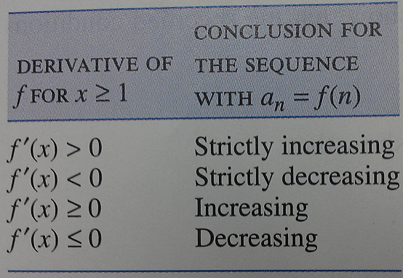

General Rule for the Third Test for Monotonicity
In general, if f(n) = $a_{n}$ is the nth term of a sequence, and if f if differentiable for x $≥1$ , then the results in the table to the right can be used to investigate the monotonicity of the sequence.

Slide 14
Properties that Hold Eventually
Sometimes a sequence will behave erratically at first and then settle down into a definite pattern.
For example, the sequence 9, -8, -17, 12, 1, 2, 3, 4, … is strictly increasing from the fifth term on, but the sequence as a whole cannot be classified as strictly increasing because of the erratic behavior of the first four terms.
To describe such sequences, we introduce the following terminology:
If discarding finitely many terms from the beginning of a sequence produces a sequence with a certain property, then the original sequence is said to have that property eventually. (Definition 9.2.2)

Slide 15
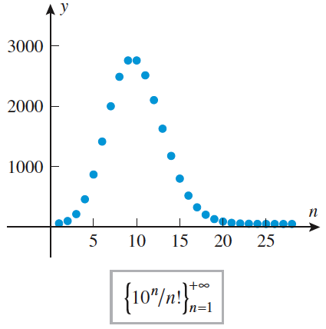

Example that is Eventually Strictly Decreasing
Show that the sequence $\left\{\frac{{10}^{n}}{n!}\right\}$_{n=1}⁺$∞$ is eventually strictly decreasing.
Solution: We have $a_{n}$= $\frac{{10}^{n}}{n!}$ and $a_{n+1}= \frac{{10}^{n+1}}{(n+1)!}$
So $\frac{a_{n+1}}{a_{n}}$ = $\frac{\frac{{10}^{n+1}}{(n+1)!}}{\frac{{10}^{n}}{n!}}$ = $\frac{{10}^{n+1}}{(n+1)!}$ * $\frac{n!}{{10}^{n}}$
= $\frac{{10}^{n}∗{10}^{1}∗n!}{\left(n+1\right)∗n!∗{10}^{n}}$ = $\frac{10}{n+1}$ < 1 for all n$≥10$
so the sequence is eventually strictly decreasing.
The graph at the left confirms this conclusion.

Slide 16
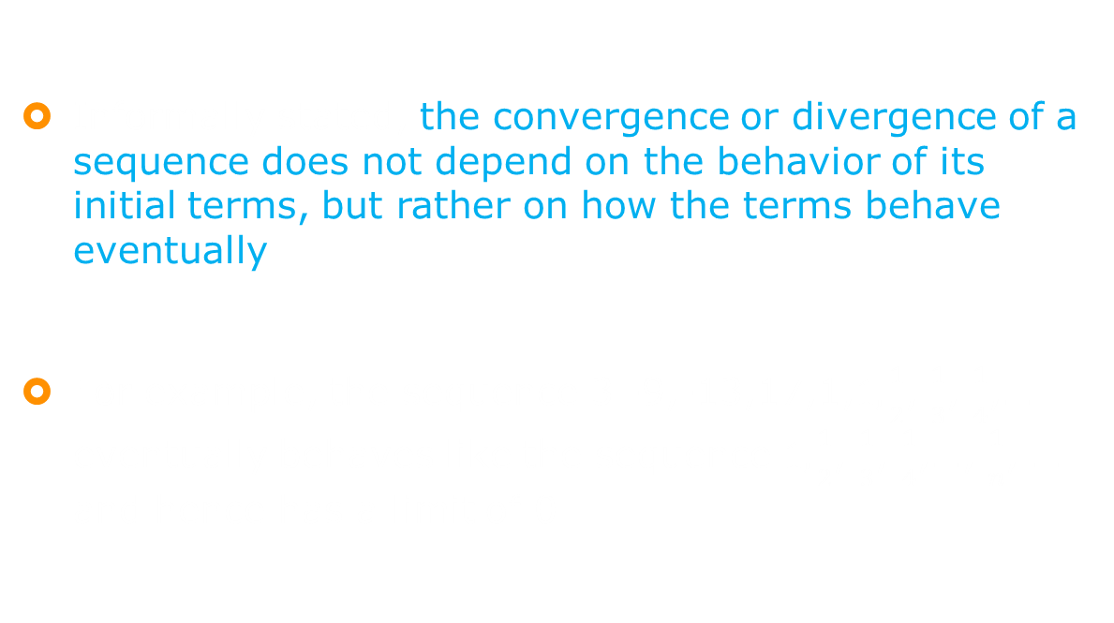
An Intuitive View of Convergence
Informally stated, the convergence or divergence of a sequence does not depend on the behavior of its initial terms, but rather on how the terms behave eventually.
For example, the sequence 3.-9,-13,17,1,$1,\frac{1}{2}$, $\frac{1}{3}$, $\frac{1}{4}$,… eventually behaves like the sequence $1,\frac{1}{2}$, $\frac{1}{3}$, $\frac{1}{4}$,…, $\frac{1}{n}$, … and hence has a limit of 0.

Slide 17
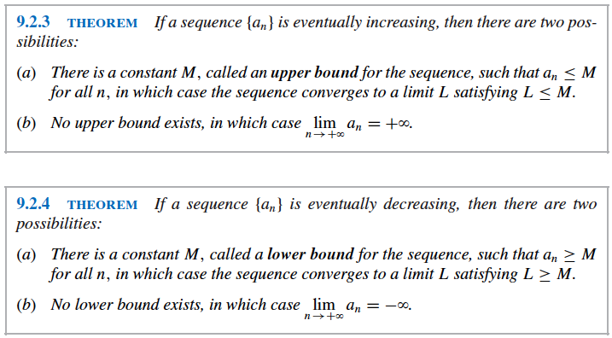
Convergence of Monotone Sequences
A monotone sequence either converges or becomes infinite – divergence by oscillation cannot occur for monotone sequences (see proof on page 612 if you are interested in why).

Slide 18

Example
The Theorems 9.2.3 and 9.2.4 on the previous slide are examples of existence theorems; they tell us whether a limit exists, but they do not provide a method for finding it.
See Example 5 on page 611 regarding use of these theorems.
It is useful to know how to turn $\frac{a_{n+1}}{a_{n}}$ = $\frac{10}{n+1}$ from slide #15 into a recursive formula $a_{n+1}$= $\frac{10}{n+1}$*$a_{n}$.
Aside from that, you can read about taking the limit of both sides, etc.

Slide 19

Golfing with My Mom

